Slide 1
Introduction to Software Defined Networks (SDN)
Irfan Ali
Slides adapted from Prof. Berk Canberk

Slide 2
Outline
Motivation- 1 (This lecture)
Centralizing the “routing/forwarding” logic
Centralizing “middleboxes”: Firewall and NAT
Motivation -2 (Next two lectures)
Data-center networks
Network-virtualization and multi-tenancy support

Slide 3
Traditional Computer Networks
Data plane:
Packet streaming
Forward, filter, buffer, mark,
rate-limit, and measure packets
Notes:
Maybe this is a better picture… though need some details of what happens in each plane… like in next slides… or, have both?

Slide 4
Traditional Computer Networks
Control plane:
Distributed algorithms
Track topology changes, compute routes, install forwarding rules
Notes:
Maybe this is a better picture… though need some details of what happens in each plane… like in next slides… or, have both?

Slide 5
Traditional Computer Networks
Management plane:
Human time scale
Collect measurements and configure the equipment
Notes:
Maybe this is a better picture… though need some details of what happens in each plane… like in next slides… or, have both?

Slide 6
Example: Traditional Network Router
Router can be partitioned into control and data plane
Management plane/ configuration
Control plane / Decision: OSPF (Open Shortest Path First)
Data plane / Forwarding
Distributed automaton
Adjacent Router
Router
Adjacent Router
Management/Policy plane
Configuration / CLI / GUI
Control Plane
Control plane
Control plane
Static routes
Control plane
OSPF
OSPF
OSPF
Neighbor table
Link state database
IP routing table
User Plane
Data plane
Data plane
Data plane
Forwarding table

Slide 7
Problems with traditional networks
Trying to “program” a particular behavior is an extremely complicated task.
Several hundred lines of configuration on each interface.
Several parameters: routing, forwarding, keep-alives.
Several very tough tradeoffs
Fast recovery vs keep-alive traffic vs false positives
Each router vendor has its own configuration language (command line interface)
Features between router vendors do not work that easily.
Every new feature from router vendor costs $$$$.

Slide 8
Software Defined Networking (SDN)
Logically-centralized control
Smart,
slow
API to the data plane
(e.g., OpenFlow)
Dumb,
fast
Switches

Slide 9
Software Defined Networking = Program the Network, Cheaply
Make it easy to “Program the network”
Centralize the control logic of the network
Use commodity hardware for user-plane
Main drivers for SDN
Reduce cost of data-center networks
Network Multi-tenancy: Enable ability to share network with multiple tenants each with their own network topology.

Slide 10
Basic SDN Motivation!
Simpler management
No need to “invert” control-plane operations
Faster pace of innovation
Less dependence on vendors and standards
Easier interoperability
Compatibility only in “wire” protocols
Simpler, cheaper equipment
Minimal software

Slide 11
What “logic/box” is being centralized?
Routing logic/Router
Match: longest destination IP prefix
Action: forward out a link
Switching logic/Switch
Match: destination MAC address
Action: forward or flood
Firewall logic/Firewall
Match: IP addresses and TCP/UDP port numbers
Action: permit or deny
Address-Port translation logic/NAT
Match: IP address and port
Action: rewrite address and port

Slide 12
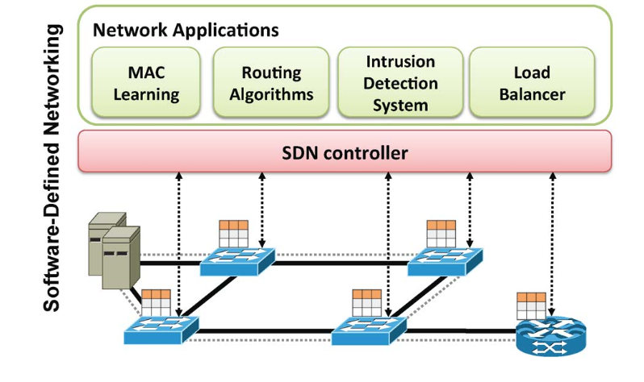
SDN High Level Architecture
North-bound Interface
Control Plane
South-bound Interface
Data Plane

Slide 13
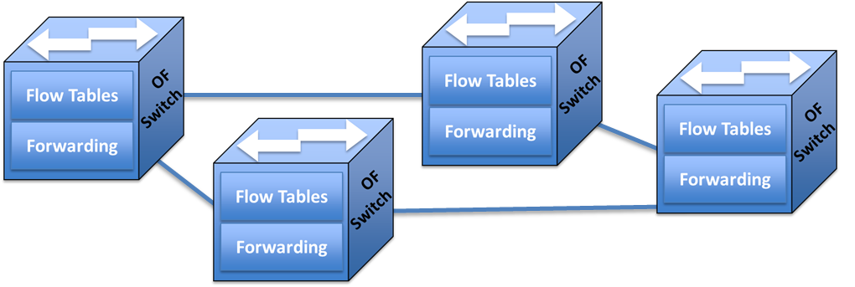
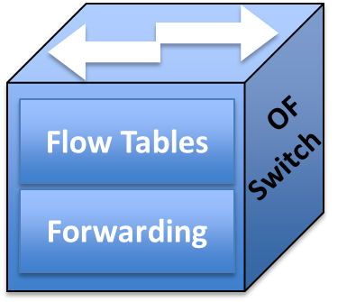
Control and Data Planes Isolation
Applications Layer:
SDN applications
Business applications
QoS
Routing
Monitoring
Traffic Eng..
North-Bound APIs
Global Network View
SDN Controller
Control-Plane Layer:
SDN Controller(s)
North-bound APIs
South-bound APIs (e.g., OpenFlow protocol)
South-Bound APIs
Data-Plane Layer:
OpenFlow(OF) Switches
Routers
Other Infrastructure elements

Slide 14


OpenFlow Switching
Controller
OpenFlow Client
PC
Software
Layer
OpenFlow Table
MAC
src
MAC
dst
IP
Src
IP
Dst
TCP
sport
TCP
dport
Action
Hardware
Layer
*
*
*
5.6.7.8
*
*
port 1
port 1
port 2
port 3
port 4
5.6.7.8
1.2.3.4
14

Slide 15
OpenFlow Switching
Switching Use Case
Switch
Port
MAC
src
MAC
dst
Eth
type
VLAN
ID
IP
Src
IP
Dst
IP
Prot
TCP
sport
TCP
dport
Action
*
*
00:1f:..
*
*
*
*
*
*
*
port6
Routing Use Case
Switch
Port
MAC
src
MAC
dst
Eth
type
VLAN
ID
IP
Src
IP
Dst
IP
Prot
TCP
sport
TCP
dport
Action
*
*
*
*
*
*
5.6.7.8
*
*
*
port6
Firewall Use Case
Switch
Port
MAC
src
MAC
dst
Eth
type
VLAN
ID
IP
Src
IP
Dst
IP
Prot
TCP
sport
TCP
dport
Action
*
*
*
*
*
*
*
*
*
22
drop

Slide 16
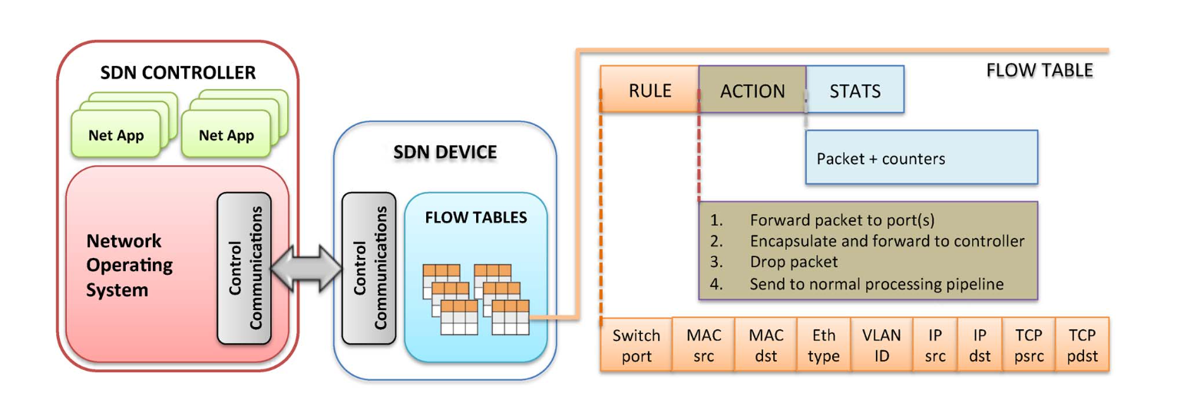
Openflow Table

Slide 17
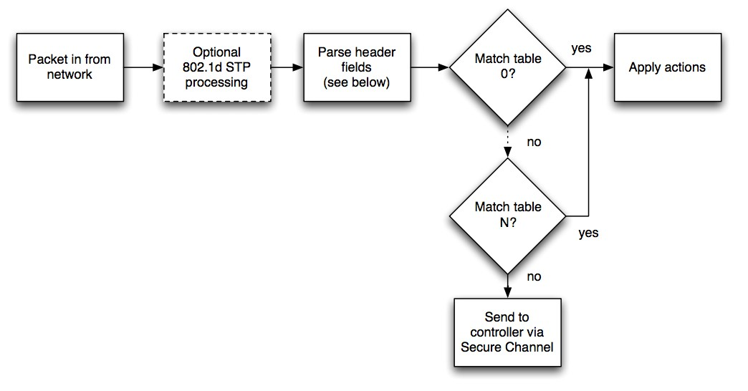
Matching (OpenFlow v. 1.0)
Packet header fields matched against one of N tables
If no match, packet is sent to controller
Otherwise, switch performs action
https://www.opennetworking.org/images/stories/downloads/sdn-resources/onf-specifications/openflow/openflow-spec-v1.0.0.pdf

Slide 18
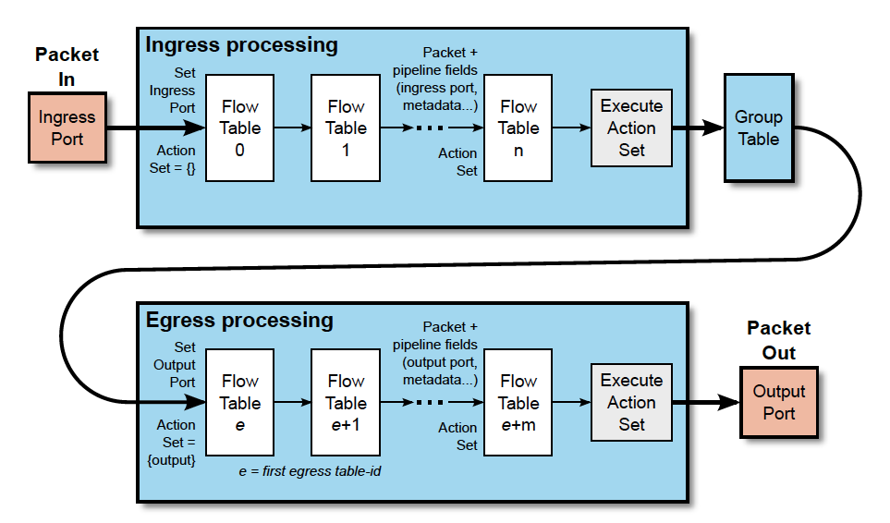
OF Tables
Packet Flow through the processing pipeline

Slide 19
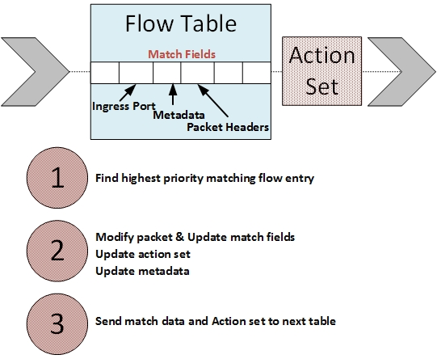
Operation and Flow Management
All incoming flow are received by the OF switches in Data Plane
In switch, the destination addresses of each flows are checked from Flow Table Pipeline
If it is matched, the actions in figure are performed
If it is not matched, that flow is called as “newcomer” flow and first packet is sent to Controller
Controller decides suitable solution, updates the flow entry and assigns a forwarding rule for this newcomer flow
-G. Secinti, B. Canberk, T. Duong, L. Shu., ‘Software Defined Architecture for VANET: A Testbed Implementation with Wireless Access Management’, IEEE Communications Magazine, 2017.

Slide 20
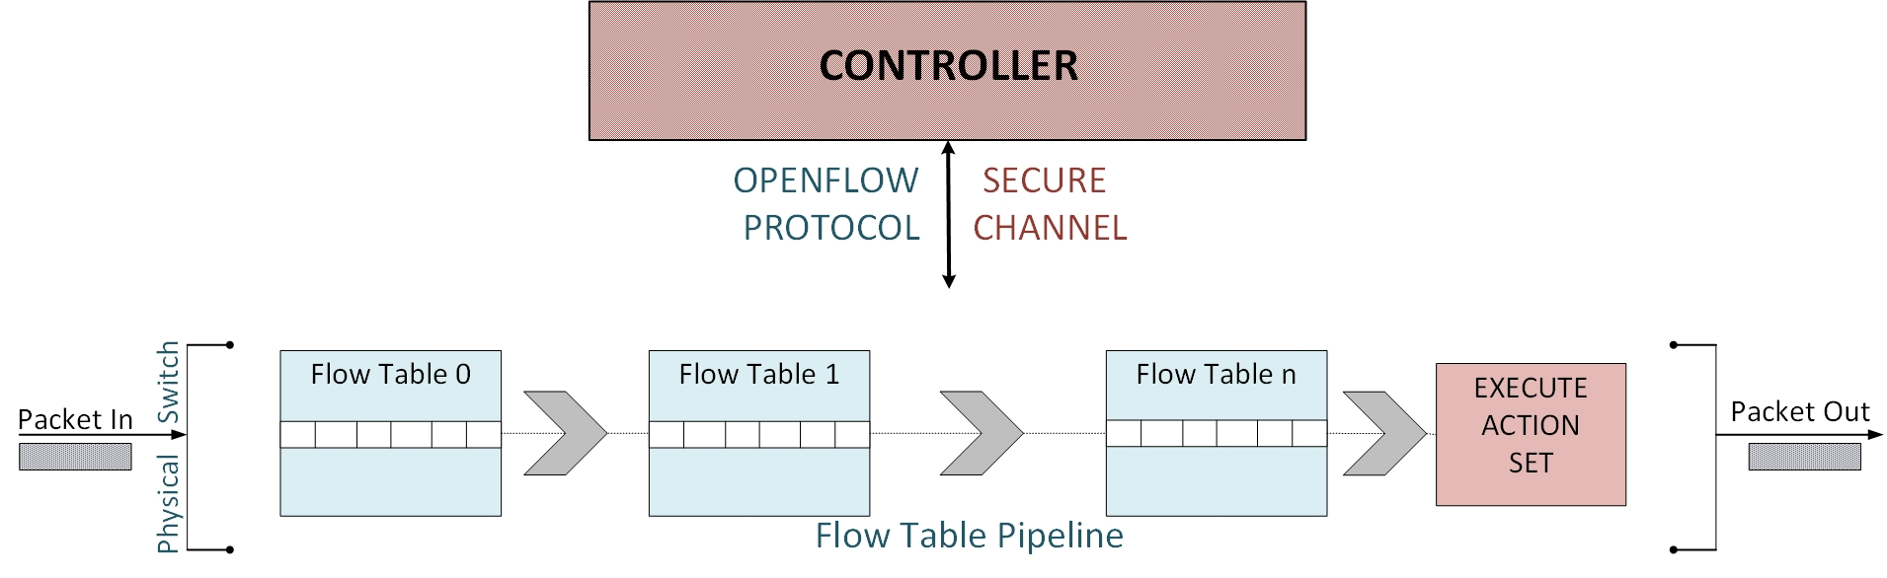
Operation and Flow Management
-G. Secinti, B. Canberk, T. Duong, L. Shu., ‘Software Defined Architecture for VANET: A Testbed Implementation with Wireless Access Management’, IEEE Communications Magazine, 2017.

Slide 21
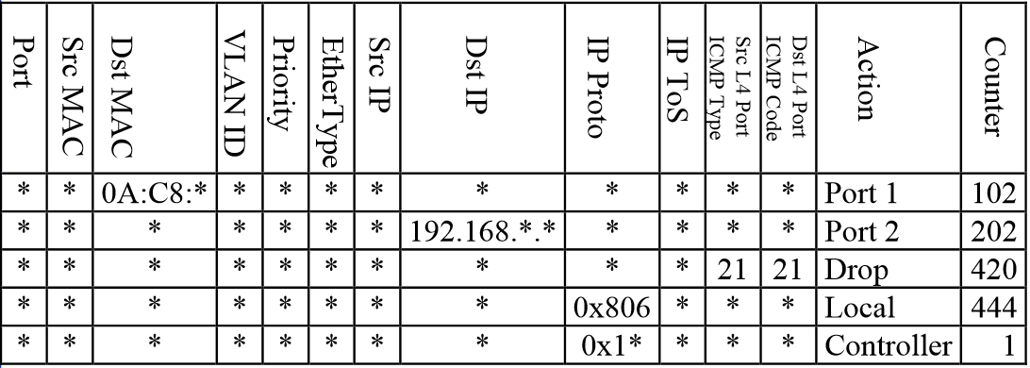
The Actual Flow Table Looks Like
Protocol
QoS

Slide 22
OpenFlow Table: Basic Actions
All To all interfaces except incoming interface.
Controller Encapsulate and send to controller.
Local send to its local networking stack.
Table Perform actions in the next flow table (table chaining or multiple table instructions).
In_port Send back to input port.
Normal Forward using traditional Ethernet.
Flood Send along minimum spanning tree except the incoming interface.

Slide 23
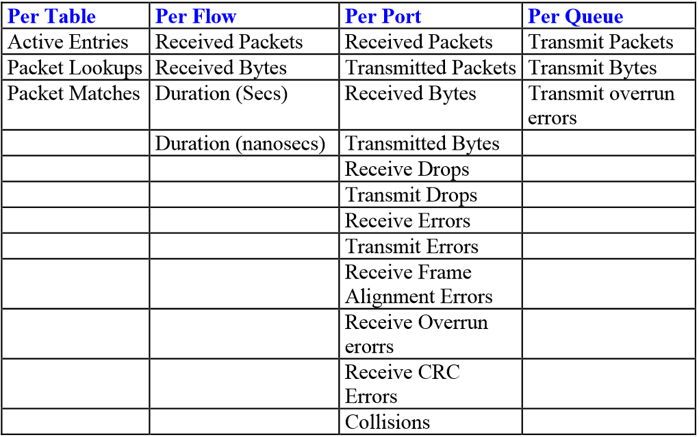
OpenFlow Table: Basic Stats
Provide counter for incoming flows or packets.
Information on counter can be retrieved to control plane.
Can be used to monitor network traffic.

Slide 24
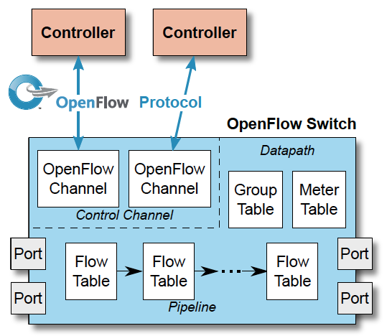
Main Components of an OF Switch

Slide 25
Main Components of an OF Switch
Control Channel: The aggregation of components of an OpenFlow logical switch that manages communication with controllers. The control channel includes one OpenFlow channel per OpenFlow controller.
OpenFlow Channel: Interface between an OpenFlow switch and an OpenFlow controller, used by the controller to manage the switch.
Datapath: The aggregation of components of an OpenFlow logical switch that are directly involved in traffic processing and forwarding. The datapath includes the pipeline of flow tables, the group table and the ports.
Group: List of action buckets and some means of choosing one or more of those buckets to apply on a per-packet basis.
Meter: Switch element that can measure and control the rate of packets. The meter triggers a meter band if the packet rate or byte rate passing through the meter exceeds a predefined threshold. If the meter band drops the packet, it is called a Rate Limiter.
Pipeline: the set of linked flow tables that provide matching, forwarding, and packet modification in an OpenFlow switch.
Flow Entry: an element in a flow table used to match and process packets. It contains a set of match fields for matching packets, a priority for matching precedence, a set of counters to track packets, and a set of instructions to apply
Flow Table: a stage of the pipeline. It contains flow entries.

Slide 26
Flow Tables and Entries
match fields: to match against packets. These consist of the ingress port and packet headers, and optionally other pipeline fields such as metadata specified by a previous table.
priority: matching precedence of the flow entry.
counters: updated when packets are matched.
instructions: to modify the action set or pipeline processing.
timeouts: maximum amount of time or idle time before flow is expired by the switch.
cookie: opaque data value chosen by the controller. May be used by the controller to filter flow entries affected by flow statistics, flow modification and flow deletion requests. Not used when processing packets.
flags: flags alter the way flow entries are managed, for example the flag OFPFF_SEND_FLOW_REM triggers flow removed messages for that flow entry.

Slide 27




New FDN
Example of Flow Management
Operation and Flow Management
New Flow Arrival
1
If the new flow does not match the flow entries at the Flow Tables
Control Link
Controller
Path Request
Data Link
2
Path Request
2
Forwarding path
Send the first packet of the new
flow to the controller
Installation of Rules
3
Installation of Rules
3
Controller computes the path for the new flow, and sends the flow entry to all OF switches
2
4
4
New Flow is forwarded to destination
3
3
3
1
4
4
4
Host
Host
-M. Erel, Z. Arslan, Y. Ozcevik, B. Canberk, ‘Grade of Service based Adaptive Flow Management for Software Defined Heterogeneous Networks’, Computer Networks (Elsevier), 2015.
-M. Erel, Z. Arslan, Y. Ozcevik, B. Canberk, ‘Software-Defined Wireless Networking’, Elsevier, 2014.

Slide 28



OpenFlow Switching
OF in action!
Controller
Alice’s Rule
Alice’s code
OpenFlow Switch
PC
Decision?
OpenFlow
Protocol
Alice’s Rule
Alice’s Rule
OpenFlow Switch
OpenFlow Switch

Slide 29
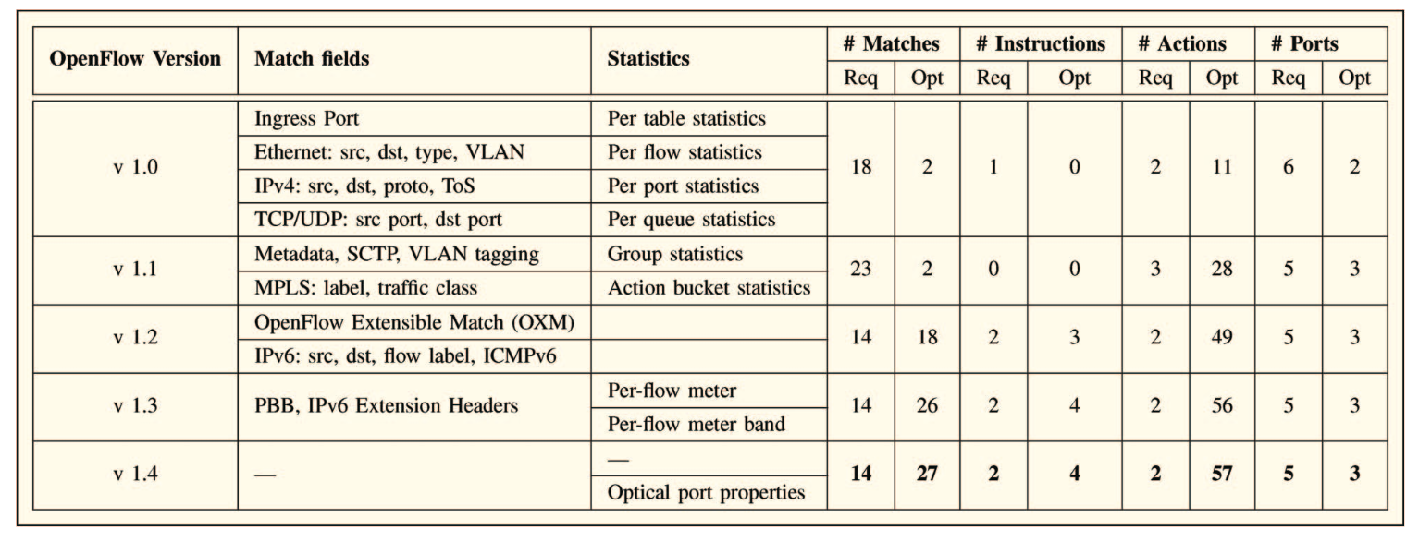
Openflow Protocol Versions
Source: Kreutz et al.: Software-Defined Networking: A Comprehensive Survey, Proceedings of IEEE 2015

Slide 30
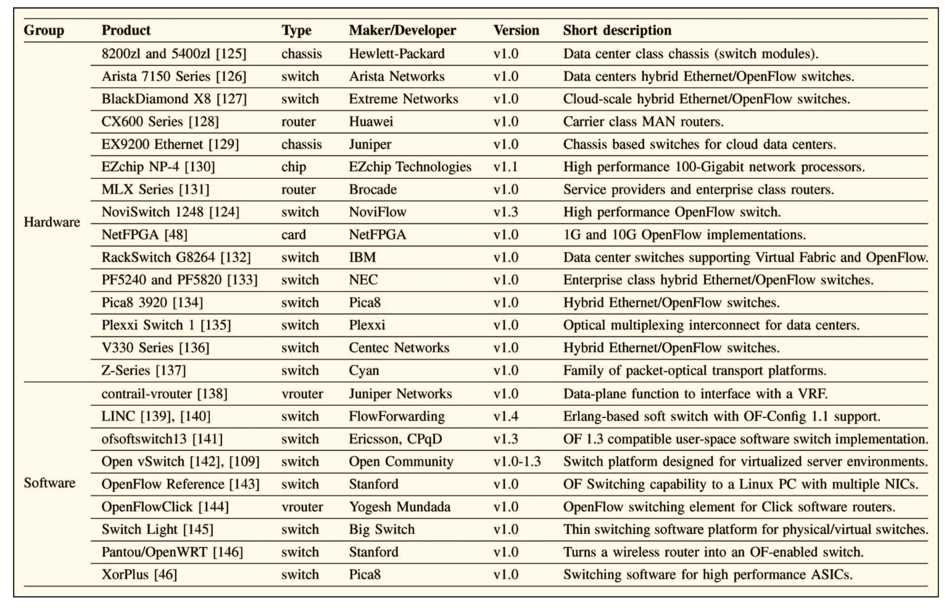
Openflow enabled hardware and software
Source: Kreutz et al.: Software-Defined Networking: A Comprehensive Survey, Proceedings of IEEE 2015

Slide 31
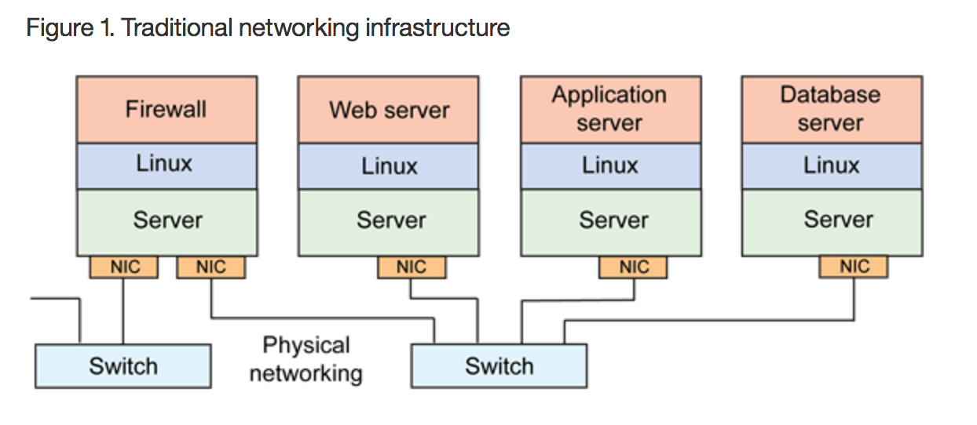
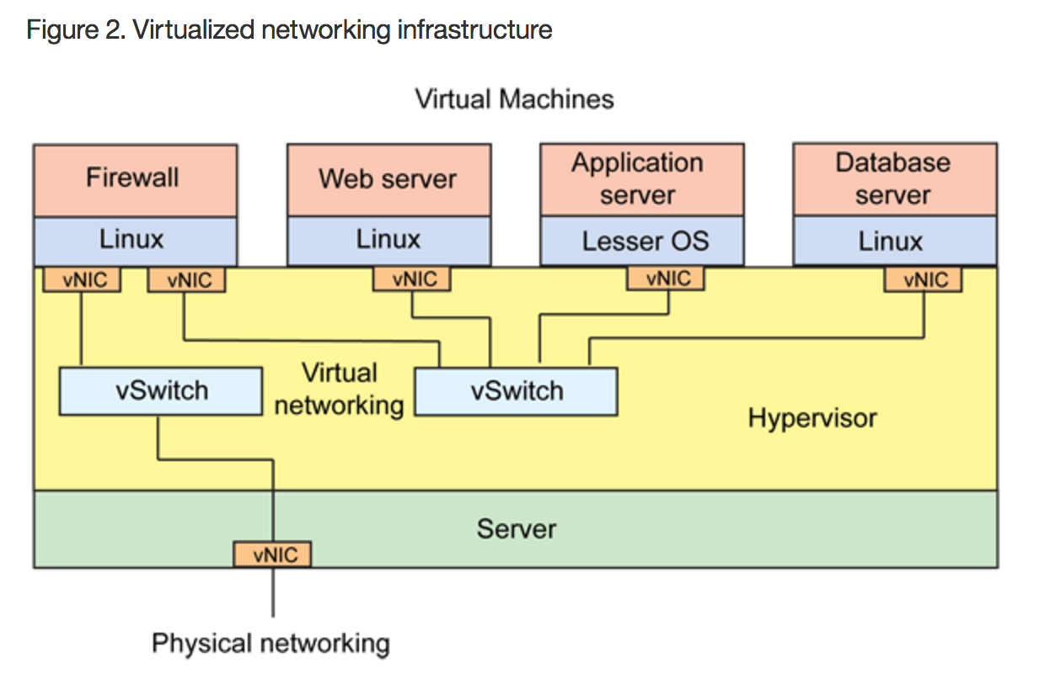
Open vSwitch
The Open vSwitch is a virtual switch that's available as open source under the Apache 2.0 license.
Open vSwitch supports the leading open source hypervisor solutions, including Kernel-based VM (KVM), VirtualBox, Xen, and XenServer. It's also a drop-in replacement for the current Linux bridge module.
Open vSwitch consists of a switch daemon and companion kernel module that manages the flow-based switching. A variety of other daemons and utilities also exist for managing the switch (particularly from the perspective of OpenFlow).
Source: https://www.ibm.com/developerworks/linux/library/l-virtual-networking/

